Slide 1
XML Transformation
SE495: Software and Systems Integration

Slide 2
Outline
Validation
XML Style Language and Transformation
XSL, XSLT, CSS, XHTML

Slide 3
Validation

Slide 4
XML Validation Using DTD and XSD
http://validator.w3.org/
XmlSchemaSet
XMLReaderSettings
XMLReader
User defined
bookstore.xsd
bookstore.dtd
bookstore.xml
User defined
Validate
The xml instance document
conforms with the
rules described
in bookstore.xsd or
bookstore.dtd

Slide 5
Validation Classes in .Net Framework
Three classes are used, and they support both DTD and XSD:
XmlSchemaSet, XMLReaderSettings, XMLReader for Validation
Use XmlSchemaSet object to hold the schemas
Link the schema set to XMLReaderSettings object
Use XmlReader to create a reader object that associates the XML file to be validated with the XMLReaderSettings object
XmlSchemaSet
to add schemas
XmlReader
Settings
XmlReader
XML Reader.Create
settings
XML File
Reader object

Slide 6
Using XmlSchemaSet Class to add schemas
using System; using System.Xml;
using System.Xml.Schema; using System.IO;
public class Sample {
public static void Main() {
// Create the XmlSchemaSet class.
XmlSchemaSet sc = new XmlSchemaSet();
// Add the schema to the collection before performing validation
sc.Add(null, "http://venus.sod.asu.edu/WSRepository/xml/Courses.xsd");
// Define the validation settings.
XmlReaderSettings settings = new XmlReaderSettings();
settings.ValidationType = ValidationType.Schema;
settings.Schemas = sc; // Association
Do not list .xsd file as a namespace of the .xml file.
Schema definition file
You could choose .DTD
settings

Slide 7
Using XmlReader.Create Method
Add an event handler
settings.ValidationEventHandler += new ValidationEventHandler(ValidationCallBack);
// Create the XmlReader object.
XmlReader reader = XmlReader.Create("http://venus.sod.asu.edu/WSRepository/xml/Courses.xml", settings);
// Parse the file.
while (reader.Read()) ; // will call event handler if invalid
Console.WriteLine("The XML file validation has completed");
}
// Display any validation errors.
private static void ValidationCallBack(object sender, ValidationEventArgs e)
{
Console.WriteLine("Validation Error: {0}", e.Message);
}
}
xmlCoursesWithErrors.xml
① XML instance file
② namespaces

Slide 8
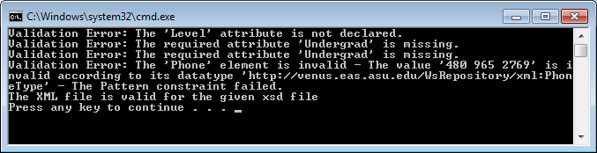

Output with Errors and Without Errors
CoursesWithErrors.xml
Courses.xsd
Courses.xml
Courses.xsd

Slide 9
Roadmap
XML Fundamentals
Elements, Attributes, and Documents, representation
XML Processing
XML Readers, XML Writers, XPath and XQuery
XML Type Definition and Validation
Document Type Definition (DTD)
XML Schema
Validation
XML Style Language and Transformation
XSL, XSLT
CSS, XHTML
Other Web Data Formats and Standards

Slide 10
XSL: Extensible Stylesheet Language
http://www.w3.org/TR/xsl/
HTML: "Format without Structure"
Typesetting language
Not extensible
XML: "Structure Without Format"
Defines "elements" using "tags"
Creates hierarchical structure of information set
XSL is a set of language technologies for defining XML document transformation and presentation
XSLT: XSL Transformations
XSL Formatting Objects or XSL-FO, is a markup language for XML document formatting which is most often used for generating PDFs
XSLT is a built-in component in ESB Enterprise Service Bus

Slide 11
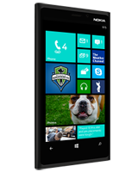
XSL: XSLT and XSL-FO
PDF
An XML document with a different structure
XSL-FO
Special formats
XML document
XSLT
XSLT
name | phone | ID
John | 4801234567 | 1234567890
Joe | 6022345678 | 9876543210
name | ID | phone
John | 1234567890 | 4801234567
Joe | 9876543210 | 6022345678

Slide 12
XSLT: XSL Transformations
XSL is a declarative (functional) programming language with constructs such as
if
choose-when-otherwise (switch)
for-each
XSL is Turing complete in theory, and thus can be used for programming any task, but limited in practice
Creates formatted output
<xsl:choose>
<xsl:when condition">
html statements
</xsl:when>
<xsl:when test="condition">
html statements
</xsl:when>
<xsl:otherwise>
html statements
</xsl:otherwise>
</xsl:choose>
Transforms one XML structure to another
Transforms XML to HTML: Adding HTML Format to XML Structure

Slide 13
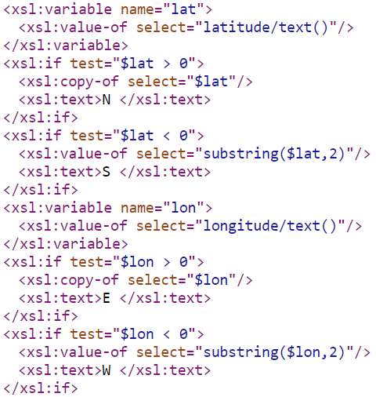
Weather.xsl that defines: variable and if
https://w1.weather.gov/xml/current_obs/latest_ob.xsl

Slide 14
XML Transformations Using a Stylesheet
Courses.xml
Courses.html
XSLT
Processor
Courses.xsl
CoursesT.xml

Slide 15
Converting XML to HTML on Client (Browser)
Put Courses.xml and Courses.xsl into a Website, e.g., in
C:\Inetpub\wwwroot (IIS virtual directory); or
http://venus.sod.asu.edu/WSRepository/xml/Courses.xml
Using the browser to convert the xml file into html by:
Test Courses.xml, with and without this line:
<?xml-stylesheet type="text/xsl" href="Courses.xsl"?>
and open the file by typing the address:
C:\Inetpub\wwwroot\Courses.xml
Repeat by adding the line
<?xml-stylesheet type="text/xsl" href="Courses.xsl"?>

Slide 16
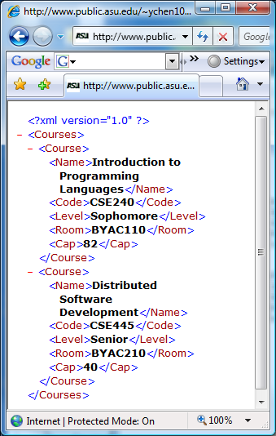
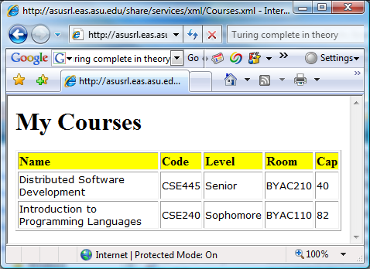
Converting XML to HTML on Client (Browser) Example: Courses.xml
<?xml version="1.0"?>
<Courses>
<Course>
<Name>Introduction to Programming Languages</Name>
<Code>CSE240</Code>
<Level>Sophomore</Level>
<Room>BYAC110</Room>
<Cap>82</Cap>
</Course>
<Course>
<Name>Distributed Software Development</Name>
<Code>CSE445</Code>
<Level>Senior</Level>
<Room>BYAC210</Room>
<Cap>40</Cap>
</Course>
</Courses>
<?xml-stylesheet type="text/xsl" href="Courses.xsl"?>

Slide 17
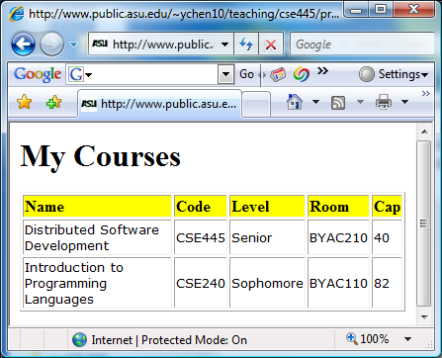


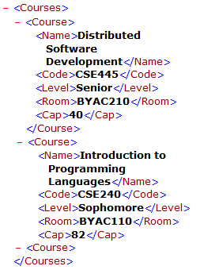
Courses.xsl that defines: for-each
<?xml version="1.0"?>
<xsl:stylesheet xmlns:xsl="http://www.w3.org/1999/XSL/Transform" version="1.0">
<xsl:template match="/">
<html> <body>
<h1>My Courses</h1>
<table border="1">
<tr bgcolor="yellow">
<td><b>Name </b></td>
<td><b>Code</b></td>
<td><b>Level</b></td>
<td><b>Room</b></td>
<td><b>Cap</b></td>
</tr>
<xsl:for-each select="Courses/Course">
<xsl:sort select="Name" />
<tr style="font-size: 10pt; font-family: verdana">
<td><xsl:value-of select="Name"/></td>
<td><xsl:value-of select="Code"/></td>
<td><xsl:value-of select="Level"/></td>
<td><xsl:value-of select="Room"/></td>
<td><xsl:value-of select="Cap"/></td>
</tr>
</xsl:for-each>
</table>
</body> </html>
</xsl:template>
</xsl:stylesheet>
Print header
Print header
Print header
Print contents

Slide 18
Another Example: Fallacies.xml: The file to be displayed
<?xml version="1.0"?>
<Fallacies>
<Fallacy>
<Number>1</Number>
<Text>The network is reliable.</Text>
<Author>Bill Joy and Tom Lyon</Author>
</Fallacy>
<Fallacy>
<Number>2</Number>
<Text>Latency is zero.</Text>
<Author>Bill Joy and Tom Lyon</Author>
</Fallacy>
<Fallacy>
<Number>3</Number>
<Text>Bandwidth is infinite.</Text>
<Author>Bill Joy and Tom Lyon</Author>
</Fallacy>
<Fallacy>
<Number>4</Number>
<Text>The network is secure.</Text>
<Author>Bill Joy and Tom Lyon</Author>
</Fallacy>
<Fallacy>
<Number>5</Number>
<Text>Topology does not change.</Text>
<Author>Peter Deutsch</Author>
</Fallacy>
<Fallacy>
<Number>6</Number>
<Text>There is one administrator.</Text>
<Author>Peter Deutsch</Author>
</Fallacy>
<Fallacy>
<Number>7</Number>
<Text>Transport cost is zero.</Text>
<Author>Peter Deutsch</Author>
</Fallacy>
<Fallacy>
<Number>8</Number>
<Text>The network is homogeneous.</Text>
<Author>James Gosling</Author>
</Fallacy>
</Fallacies>

Slide 19
Fallacies.xsl: The stylesheet file
<?xml version="1.0"?>
<xsl:stylesheet xmlns:xsl="http://www.w3.org/1999/XSL/Transform" version="1.0">
<xsl:template match="/">
<html> <body>
<h1 style="background-color: blue; color: white; font-size: 18pt; text-align: center">
Eight Fallacies in Distributed Computing
</h1>
<table border="1">
<tr style="font-size: 12pt; font-family: verdana; font-weight: bold">
<td style="text-align: center">Number</td>
<td style="text-align: center">Fallacy</td>
<td style="text-align: center">Author</td>
</tr>
<xsl:for-each select="Fallacies/Fallacy">
<xsl:sort select="Number" />
<tr style="font-size: 12pt; font-family: verdana">
<td><i><xsl:value-of select="Number"/></i></td>
<td><xsl:value-of select="Text"/></td>
<td><xsl:value-of select="Author"/></td>
</tr>
</xsl:for-each>
</table>
</body> </html>
</xsl:template>
</xsl:stylesheet>
Print header
Print contents

Slide 20
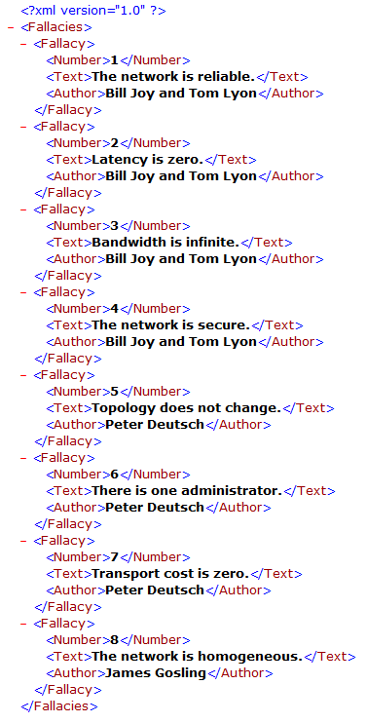
Without using the XSL File

Slide 21
Demonstration using Client Conversion
Put the two Files into a IIS virtual Directory
Using client side conversion: add a line of directive:
<?xml-stylesheet type="text/xsl" href="Fallacies.xsl"?>
after the first of prolog.
Type the address in your browser:
C:\Inetpub\wwwroot\Fallacies.xml
You can test it on your Windows IIS
OR, put them in any remote Web server, e.g.:
http://venus.sod.asu.edu/WSRepository/xml/Fallacies.xml

Slide 22
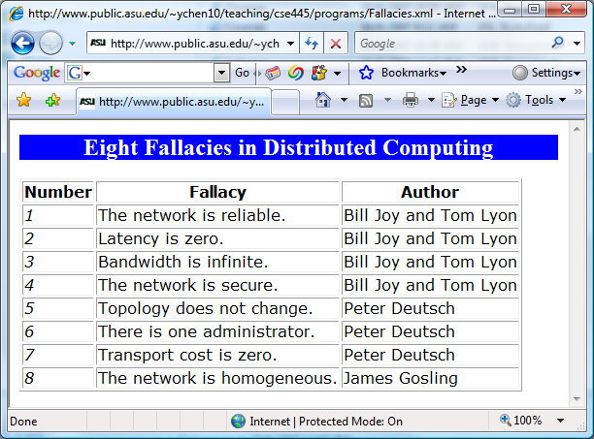
The Display of the Page

Slide 23
Converting XML to HTML on Server Side
Two potential problems with the client-side conversion:
Need to modify the xml file (to reference an xsl file)
Browser dependent
Not all browsers have an embedded XSLT processor;
Not all versions of the browser has an embedded XSLT processor.
To ensure that your page can be displayed properly, you need to write a program the conversion on the server side: Writing a .aspx file using a program to do the conversion.

Slide 24
Members of XslCompiledTransform Class
Method Name | Description
Equals | Overloaded. Determines whether two Object instances are equal. (inherited from Object)
GetHashCode | Serves as a hash function for a particular type. (inherited from Object)
GetType | Gets the Type of the current instance. (inherited from Object)
Load | Overloaded. Loads the XSLT style sheet, including style sheets referenced in xsl:include and xsl:import elements.
ReferenceEquals | Determines whether the specified Object instances are the same instance. (inherited from Object)
ToString | Returns a String that represents the current Object. (inherited from Object)
Transform | Overloaded. Transforms the XML data using the loaded XSLT style sheet.

Slide 25
Do it in C# in Console: Translate XML into html
Command line input: Fallacies.xml Fallacies.xsl
class MyXSLTApp {
static void Main(string[ ] args) {
if (args.Length < 2) {
Console.WriteLine(“Error: Files required not found");
return;
}
try {
XPathDocument doc = new XPathDocument(args[0]);
XslCompiledTransform xt = new XslCompiledTransform();
xt.Load(args[1]);
xt.Transform(doc, null, Console.Out);
}
catch (Exception ex) {
Console.WriteLine(ex.Message);
}
string x = Console.ReadLine();
}
}

Slide 26
Do it in C#: How to do it step by step?
Create a C# Console Application
Copy and Paste the C# code into the application
Build/Compile your program
Choose Visual Studio menu “Project” -> “Properties…”
Click on Debug -> Command Arguments
Enter Fallacies.xml Fallacies.xsl files as the command line arguments (See next page)
Browse to the Working directory where your Fallacies.xml and Fallacies.xsl files are located
Run the program
The html file will be generated (see following page).

Slide 27
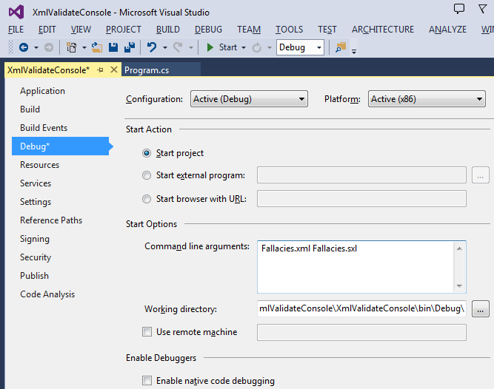
Project → Properties … Setting Up Command Line Input

Slide 28
The output of the program: html file
<html>
<body>
<h1 style="background-color: blue; color: white; font-size: 18pt; text-align: center">
Eight Fallacies in Distributed Computing
</h1>
<table border="1">
<tr style="font-size: 12pt; font-family: verdana; font-weight: bold">
<td style="text-align: center">Number</td>
<td style="text-align: center">Fallacy</td>
<td style="text-align: center">Author</td>
</tr>
<tr style="font-size: 12pt; font-family: verdana">
<td>
<i>1</i>
</td>
<td>The network is reliable.</td>
<td>Bill Joy and Tom Lyon</td>
</tr>
<tr style="font-size: 12pt; font-family: verdana">
<td>
<i>2</i>
</td>
<td>Latency is zero.</td>
<td>Bill Joy and Tom Lyon</td>
</tr>
<tr style="font-size: 12pt; font-family: verdana">
<td>
<i>3</i>
</td>
<td>Bandwidth is infinite.</td>
<td>Bill Joy and Tom Lyon</td>
</tr>
<tr style="font-size: 12pt; font-family: verdana">
<td>
<i>4</i>
</td>
<td>The network is secure.</td>
<td>Bill Joy and Tom Lyon</td>
</tr>
<tr style="font-size: 12pt; font-family: verdana">
<td>
<i>5</i>
</td>
<td>Topology does not change.</td>
<td>Peter Deutsch</td>
</tr>
<tr style="font-size: 12pt; font-family: verdana">
<td>
<i>6</i>
</td>
<td>There is one administrator.</td>
<td>Peter Deutsch</td>
</tr>
<tr style="font-size: 12pt; font-family: verdana">
<td>
<i>7</i>
</td>
<td>Transport cost is zero.</td>
<td>Peter Deutsch</td>
</tr>
<tr style="font-size: 12pt; font-family: verdana">
<td>
<i>8</i>
</td>
<td>The network is homogeneous.</td>
<td>James Gosling</td>
</tr>
</table>
</body>
</html>

Slide 29
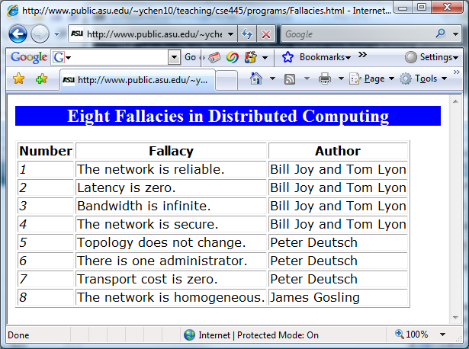
Put this html file into a Website
http://venus.sod.asu.edu/WSRepository/xml/Fallacies.html

Slide 30
Web Application: Embed C# Code in Fallacies.aspx
<%@ Page Language="C#" %>
<%@ Import Namespace="System.Xml.XPath" %>
<%@ Import Namespace="System.Xml.Xsl" %>
<%
XPathDocument doc =
new XPathDocument (Server.MapPath ("Fallacies.xml"));
XslCompiledTransform xt = new XslCompiledTransform();
xt.Load (Server.MapPath ("Fallacies.xsl"));
xt.Transform(doc, null, Response.OutputStream);
%>
Send the return value as an html stream to Web browser.

Slide 31
CSS: Cascading Style Sheets and its use in HTML and XML
In HTML, within an element tag: <link REL="STYLESHEET" TYPE="text/css" HREF="UrlOfCssStyleSheet">
In XML: As an Processing Information (PI) the prologue of an XML document: <?xml-stylesheet href="UrlOfCssStyleSheet" type="text/css"?>
Example (http://www.w3.org/Style/styling-XML.en.html):
<?xml-stylesheet href="common.css"?>
<?xml-stylesheet href="modern.css" title="Modern" media="screen"
type="text/css"?>
<?xml-stylesheet href="classic.css" alternate="yes" title="Classic"
media="screen, print" type="text/css"?>

Slide 32
CSS Language Rules
Element selected for applying the style
body
{
font-family: Arial;
color: blue;
background: yellow;
margin: 8px;
}
Style for the element
Attribute
Value

Slide 33
Example
common.css
HTML:
body
{
font-family: Tahoma, Arial, sans-serif;
font-size: 14px;
color: blue;
background: yellow;
margin: 8px;
}
h1 {
font-size: 18px;
margin-top: 14px;
margin-bottom: 6px;
border-bottom: 2px solid black
}
<link href=“common.css”
rel=“stylesheet”
type=“text/css” />
<body>
<h1>First Level Heading</h1>
One evening, just as he was getting
his flute ready and his musicians were assembled, an officer brought
him a list of the strangers who had arrived.
<h2>Second Level Heading</h2>
A new paragraph here.
</body>

Slide 34
CSS Application Example in XML Files http://www.w3.org/Style/styling-XML.en.html
Define multiple CSS files to switch the view of the page
<?xml-stylesheet href="common.css"?>
<?xml-stylesheet href="modern.css" title="Modern" media="screen"
type="text/css"?>
<?xml-stylesheet href="classic.css" alternate="yes" title="Classic"
media="screen, print" type="text/css"?>
<ARTICLE>
<HEADLINE> Fredrick the Great meets Bach </HEADLINE>
<AUTHOR>Johann Nikolaus Forkel</AUTHOR>
<PARA> One evening, just as he was getting his
<INSTRUMENT>flute</INSTRUMENT>
ready and his musicians were assembled, an officer brought him
a list of the strangers who had arrived.
</PARA>
</ARTICLE>
Define styles for the elements in .css file

Slide 35
What is XHTML (Extensible HTML)?
Problems with HTML:
It has a fixed set of tags, and thus is not extensible;
Many browser-specific tags are added.
How can these problems be addressed?
Add a document type definition file (DTD) or XSD schema
XHTML allows three different ways to add a DTD file
Strict DTD: Enforce the structure by restricting to those tags defined in the DTD;
Transitional DTD: Allow all the depreciated features/tags to be migrated into the new page;
Frameset DTD: Same as Transitional DTD, but replaced the <body> with the <frame>, which allows developers to share the frames in multiple pages.

Slide 36
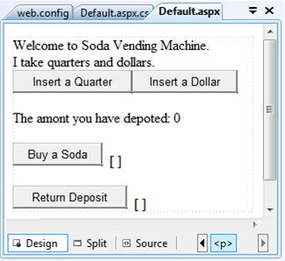
Application of XHTML in ASP .Net
<%@ Page Language="C#" AutoEventWireup="true" CodeFile="Default.aspx.cs" Inherits="_Default" %>
<!DOCTYPE html PUBLIC "-//W3C//DTD XHTML 1.0 Transitional//EN" "http://www.w3.org/TR/xhtml1/DTD/xhtml1-transitional.dtd">
<html xmlns="http://www.w3.org/1999/xhtml">
<head runat="server">
<title>Vending Machine</title>
</head>
<body>
<form id="form1" runat="server">
<div>
Welcome to Soda Vending Machine. <br />
I take quarters and dollars.<br />
</div>
<asp:Button ID="Button1" runat="server" onclick="Button1_Click"
Text="Insert a Quarter" />
<asp:Button ID="Button2" runat="server" onclick="Button2_Click"
Text="Insert a Dollar" />
<p>
The amont you have depoted:
<asp:Label ID="lblAmount" runat="server" Text="0"></asp:Label>
</p>
<asp:Button ID="btnSoda" runat="server" onclick="Button3_Click"
Text="Buy a Soda" />
<asp:Label ID="lblSoda" runat="server" Text="[ ]"></asp:Label> <br />
<br />
<asp:Button ID="btnRtn" runat="server" onclick="Button4_Click"
Text="Return Deposit" />
<asp:Label ID="lblRtn" runat="server" Text="[ ]"></asp:Label>
<br />
</form>
</body>
</html>

Slide 37
Development of Web Presentation Languages
1991 HTML
1994 HTML 2
1996 CSS 1 + JavaScript
1997 HTML 4
1998 CSS 2
2000 XHTML
2005 AJAX
2008 XAML
2009 HTML5
Animation can be programmed
JavaScript / JQuery
= XHTML + CSS + AJAX + Silverlight
= HTML + CSS + JavaScript / JQuery
Animation can be programmed

Slide 38
Roadmap
XML Fundamentals
Elements, Attributes, and Documents, representation
XML Processing
XML Readers, XML Writers, XPath and XQuery
XML Type Definition and Validation
Document Type Definition (DTD). XML Schema, Validation
XML Style Language and Transformation
XSL, XSLT
CSS, XHTML
Other Web Data Formats and Standards
Google Protocol Buffers and Big Table
Feed: RSS and Atom, JSON
HTTP Operations
Ontology languages: Complex XML
Lecture 18

Slide 39
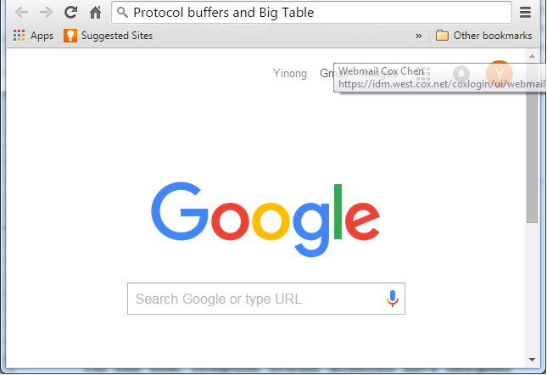
Google Data Description and Management
Googol
Protocol buffers and Big Table

Slide 40
How can Google be so fast?
Distributed and Parallel Computing: Buildings of machines
Crawling and Indexing Working 24/7
Caching Buffering the frequently and recently used links and pages
Specifically designed service-oriented computing model: Removing SOAP, using HTTP directly: RESTful service, instead of WSDL/SOAP services
Specifically designed data structures and data management

Slide 41
Google Data Description Language? XML and XML Schema?
What is the data description language used by Google?
XML is universal and standard for representing data on Web;
XML may be slow for Google’s amount of Data;
Think about the amount of information stored in Google directories – Any efficiency improvement will be significant;
A good design needs compromise / tradeoff between flexibility and efficiency

Slide 42
Google Protocol Buffers
http://code.google.com/apis/protocolbuffers/docs/overview.html
Compared to XML and XML Schema, Protocol buffers:
are simpler
are 3 to 10 times smaller in presenting the same information
are 20 to 100 times faster in processing
are less ambiguous
generate data structures that are similar to object-oriented classes and thus are easier to use programmatically
are less flexible/adaptable

Slide 43
Google Protocol Buffers Example
message Person {
required string name = 1;
required int32 id = 2;
optional string email = 3;
enum PhoneType {
WORK = 0;
HOME = 1;
MOBILE = 2;
}
message PhoneNumber {
required string number = 1;
optional PhoneType type = 2 [default = WORK];
}
repeated PhoneNumber phone = 4;
}

Slide 44
A Similar Description in XML Schema
<element name = Person>
<complexType>
<sequence>
<element name = "Id" type="integer" minOccurs="1" maxOccurs="1"/>
<element name = "Name" type="string" minOccurs="1" maxOccurs="1"/>
<element name = "Email" type="string" minOccurs="0" maxOccurs="1"/>
<element name = "Phone" type="string" minOccurs="1" maxOccurs="1"/>
</sequence>
</complexType>
</element>
<element name = "Phone" >
<simpleType>
<restriction base = "string" >
<enumeration value = "Work" type=minOccurs="1" maxOccurs="1"/>
<enumeration value = "Home" minOccurs="0" maxOccurs="1"/>
<enumeration value = "Mobile" minOccurs="0" maxOccurs="1"/>
</restriction>
</element >

Slide 45
Using Protocol Buffer for Service Development: gRPC
Lecture 10
https://cloud.google.com/endpoints/docs/grpc/about-grpc
https://www.grpc.io/docs/
gRPC is a high performance, open-source universal RPC framework, developed by Google.
In gRPC, a client application can directly call methods on a server application on a different machine as if it was a local object, making it easier to create distributed applications and services.
gRPC exposes endpoints to the outside to enable different types of clients.
gRPC client
HTTP / JSON clients
We show an example of using Visual Studio to develop a gRPC service and client

Slide 46
Google BigTable
http://en.wikipedia.org/wiki/BigTable
BigTable is a fast and extremely large-scale database management system;
It is a compressed, high performance, and proprietary database system built on Google File System (GFS);
It departs from the convention of relational database, with a fixed number of columns;
The database is “a sparse, distributed multi-dimensional sorted map”.
What is it?
The idea is similar to B Tree and B+ Tree that allow for efficient insertion, retrieval and removal of nodes.

Slide 47
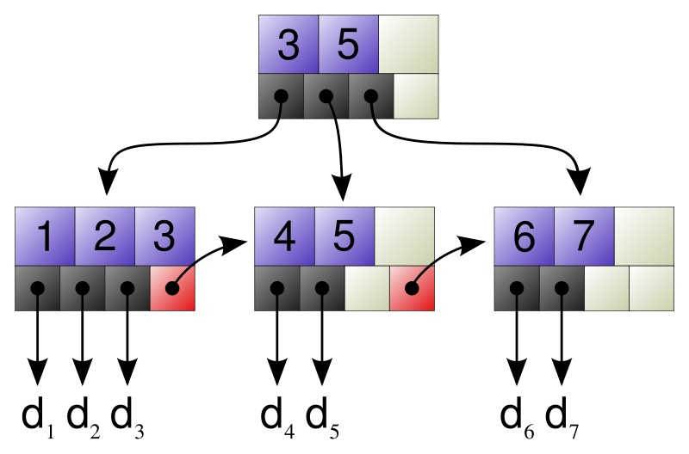
B Tree and B+ Tree
http://en.wikipedia.org/wiki/B%2B_tree
It extends the binary search tree.
It is a tree representing sorted data in a way that allows for efficient insertion, retrieval and removal of records, each of which is identified by a key: key-value database.
It is a dynamic, multilevel index, with maximum and minimum bounds on the number of keys in each index node.
In a B+ tree, in contrast to a B Tree, all records (values) are stored at the lowest level of the tree (leafs). Only keys are stored in interior blocks

Slide 48
B+ Tree-Based BigTable (Key-Value Store)
Keys are sorted in certain traversing order
Root Index keys
•
12
•
31
•
38
•
47
•
Level Two Index
•
2
•
5
•
9
•
•
•
20
•
21
•
26
•
30
•
•
32
•
36
•
•
•
•
GFS
(Store Values)
d₁
d₂
d₃
d₄
d₅
d₆
d₇
d₈
d₉
d_{n}

Slide 49
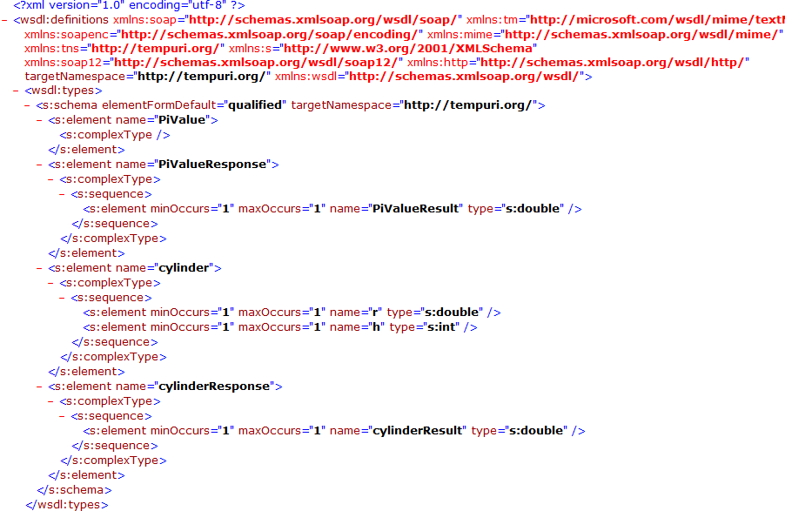
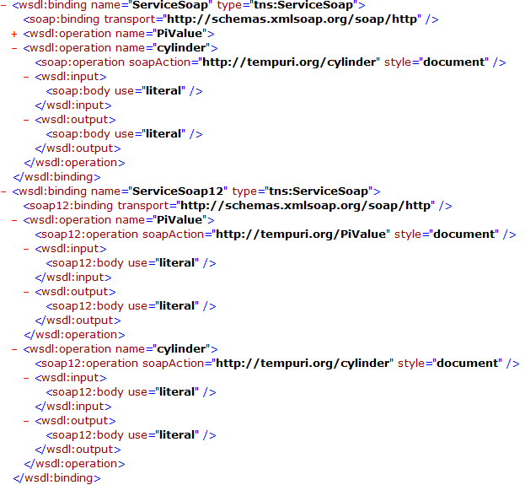
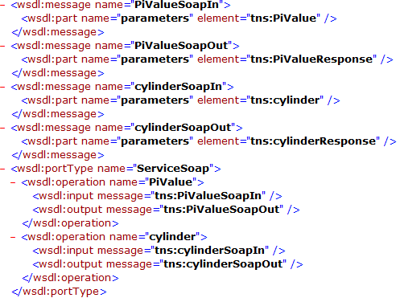
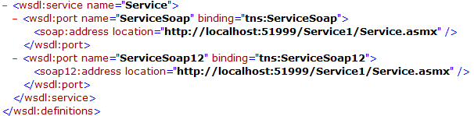
Elective Service Idea: Generating a Structured View for the WSDL of a Service

Slide 50
Elective Service Idea: Creating Users XML
User Information in XML
Users
The example of storing data into a File Service in Chapter 3
User
User
User
User
Name
Phone

